Slide 1
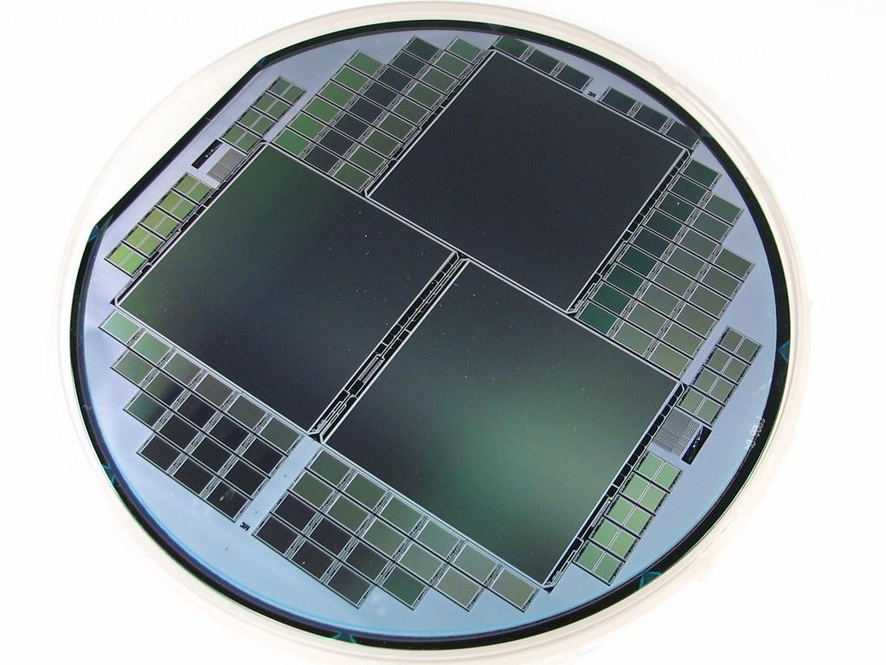
EAS 509 Statistical Learning and Data Mining – I I
Fetal Cardiotocogram Patterns

Slide 2


TEAM MEMBERS
Abhiram Siddoju 50442313
Suriya Badrinath 50442121
Gowtham Kumar
50442715
Kaviyaa Vasudevan 50443082

Slide 3

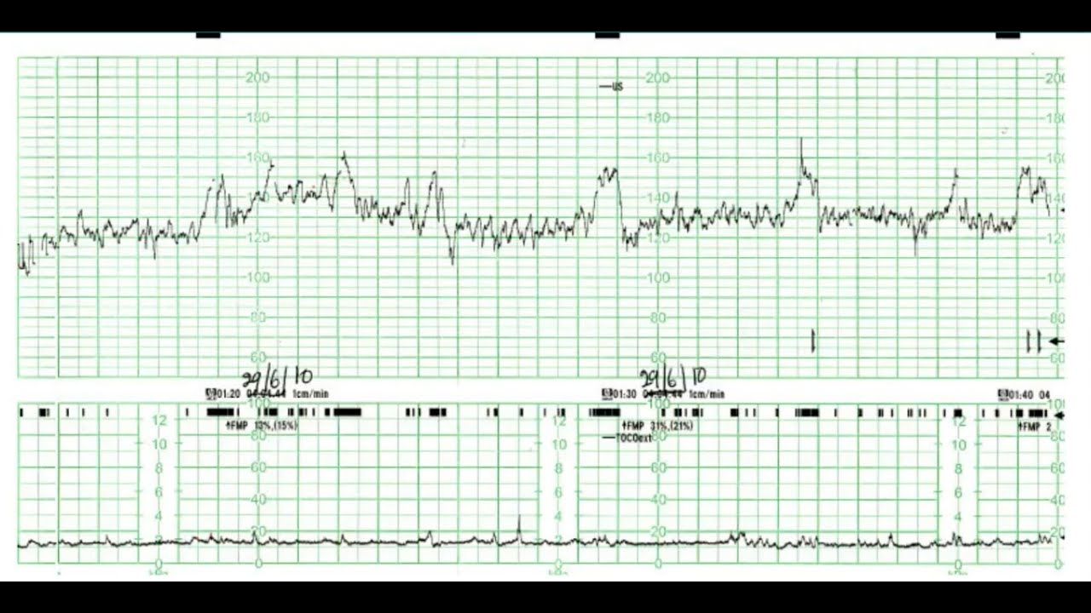
PROBLEM STATEMENT
The CTG is widely used for assessment of fetal wellbeing and has been the mainstay of fetal monitoring for over 50 years.
The fetal heart rate fluctuations and their temporal correlation with uterine contractions are captured by cardiotocography (CTG). The goal of obtaining a cardiotocography analysis is to identify infants who may be anemic (hypoxic) in order to direct further evaluations of fetal welfare or decide whether the baby has to be delivered through caesarean section or assisted vaginal birth.
The diagnostic features were measured and automatically processed from 2126 Fetal Cardiotocograms (CTGs). Three knowledgeable obstetricians classified the CTGs, morphologic pattern and fetal condition were used to classify the samples into (Normal-1, Suspect-2, Pathologic-3).

Slide 4
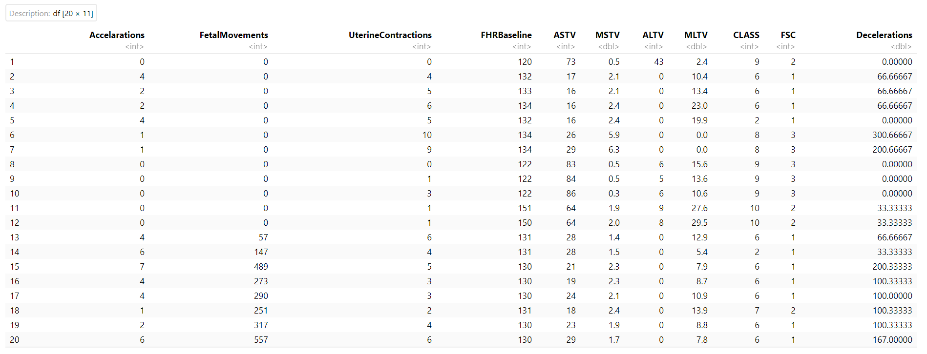
DATASET
Source - UCI
https://archive.ics.uci.edu/ml/datasets/cardiotocography

Slide 5
DATASET DESCRIPTION
Rows: 2116 Columns: 11
Accelerations: Number of accelerations per second
Fetal Movements: Number of fetal movements per second
Uterine Contractions: Number of uterine contractions per second
FHR baseline:FHR baseline (beats per minute)
ASTV: Percentage of time with abnormal short-term variability
MSTV: Mean value of short-term variability
ALTV: Percentage of time with abnormal long-term variability
MLTV: Mean value of long-term variability CLASS: FHR pattern class code (1 to 10)
FSC: Fetal State Class code (1=Normal; 2=Suspect; 3=Pathologic)
Decelerations: Number of decelerations per second
Here our target variable is FSC, which is the Fetal State Class based on the other10 Predictor variables.

Slide 6
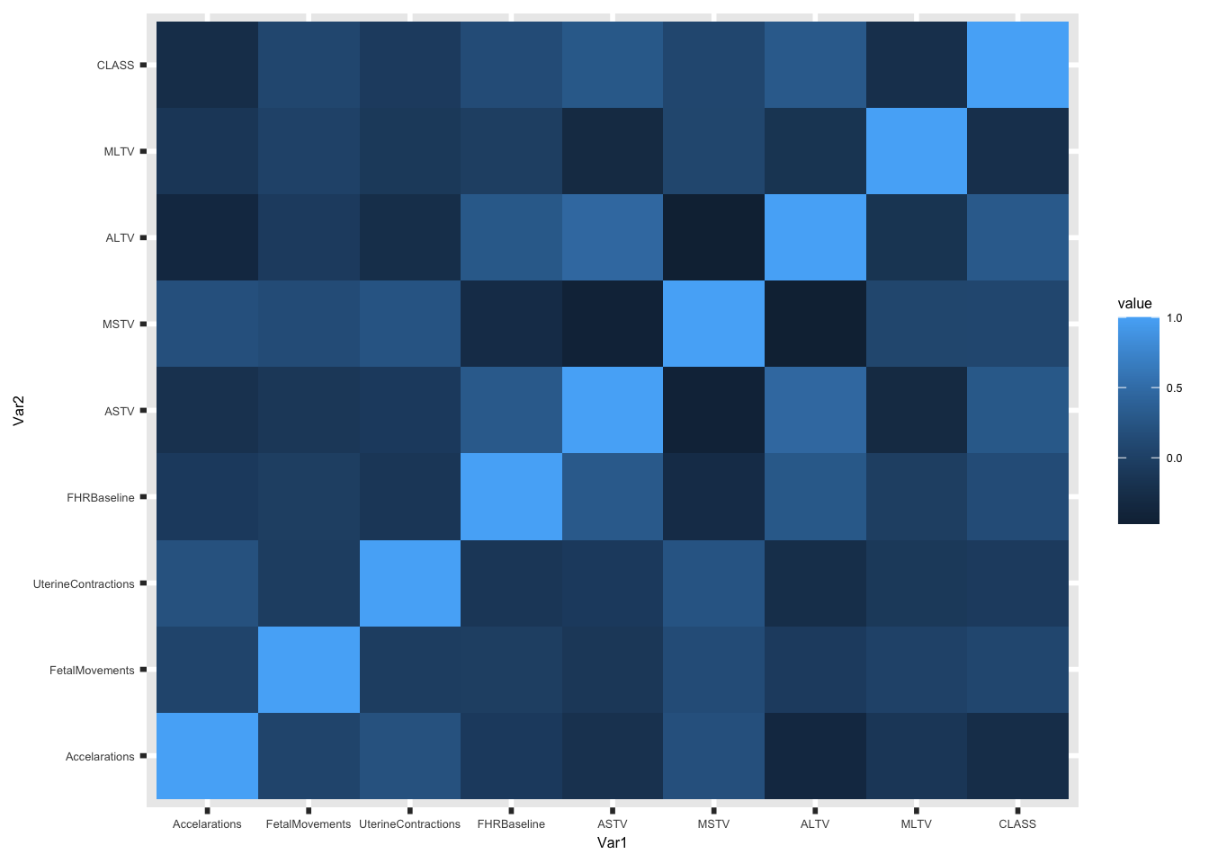
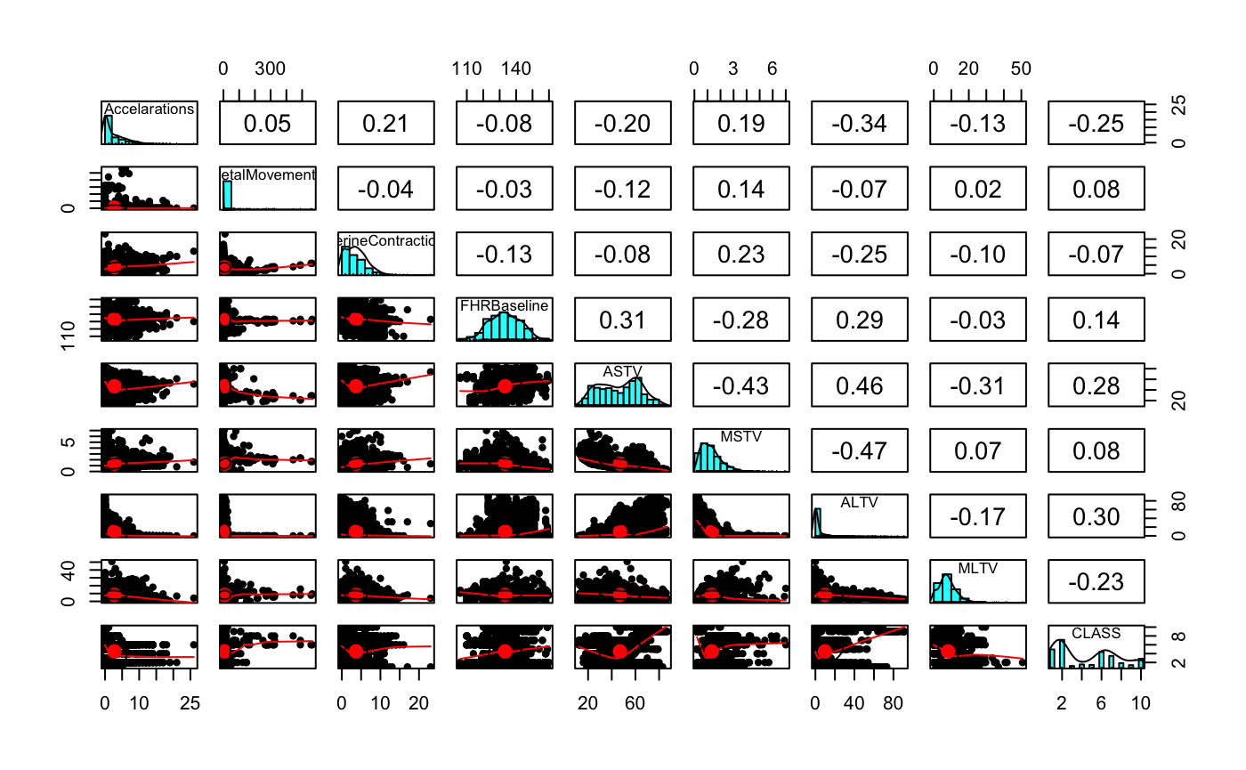
FEATURE ENGINEERING
There are no highly correlated features, so we have considered all 10 predictor columns for model deployment

Slide 7
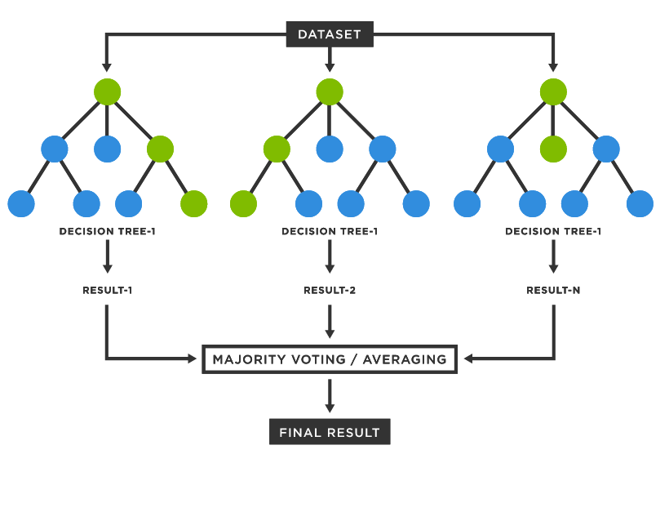
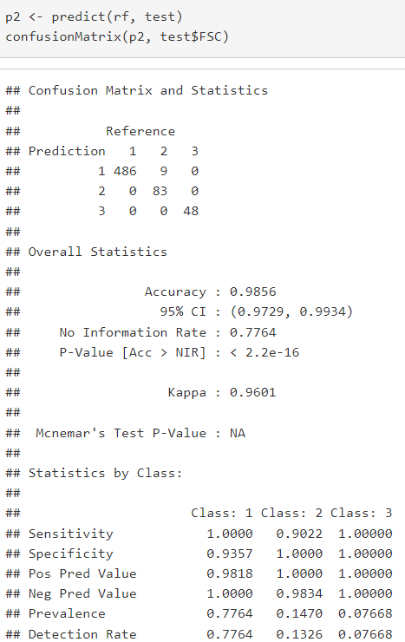
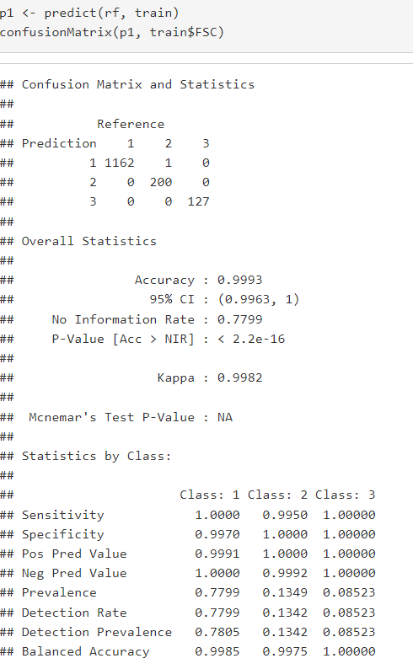
RANDOM FOREST CLASSIFIER
The random forest technique can also handle big data with numerous variables running into thousands. It performs better results for classification problems.
We split the data into 70% for training and remaining 30 % for testing, for after deploying the model we got the below depicted results
As we can see we got 99.93% accuracy for testing and 98.56% accuracy for training.

Slide 8
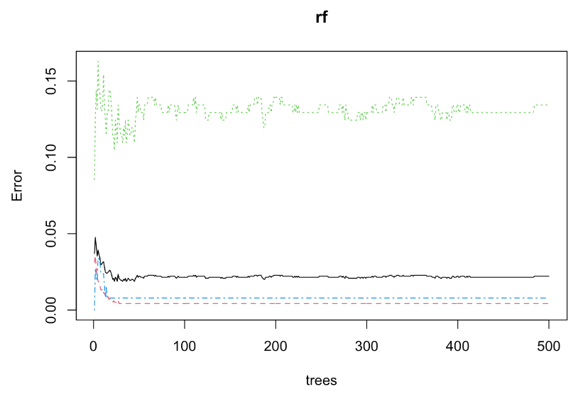
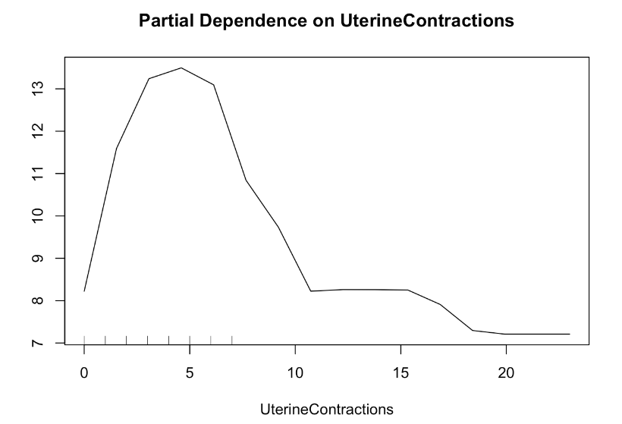
RANDOM FOREST CLASSIFIER
From the graph it very much evident that we don’t need further tuning of parameters since the model is predicted with higher accuracy.
Partial dependence of FSC on the number of Uterine Contractions is depicted below

Slide 9
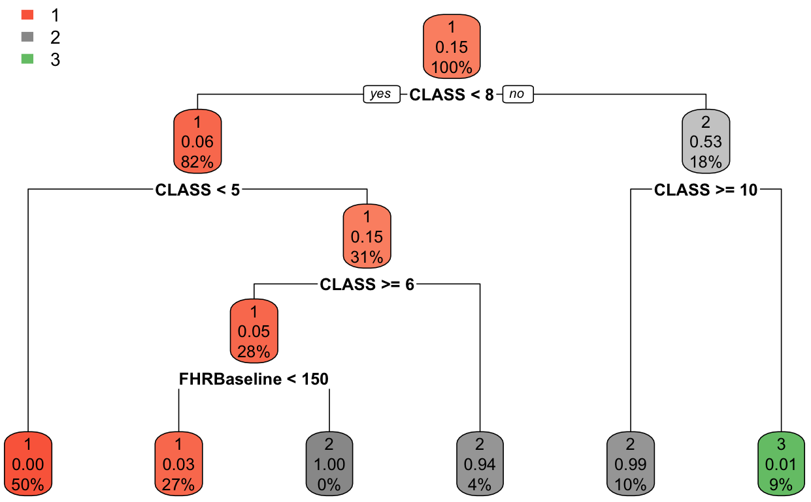
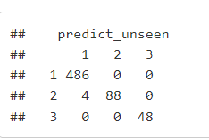
DECISION TREE CLASSIFIER
Here we used Decision tree classifier because of its ability to using different feature subsets and decision rules at different stages of classification.
After deploying the model, we got the accuracy as 99.36% which is quite close to RF accuracy
The confusion matrix and decision tree is depicted below

Slide 10
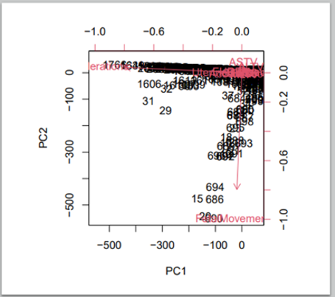
PCA Biplot of our dataset

Slide 11
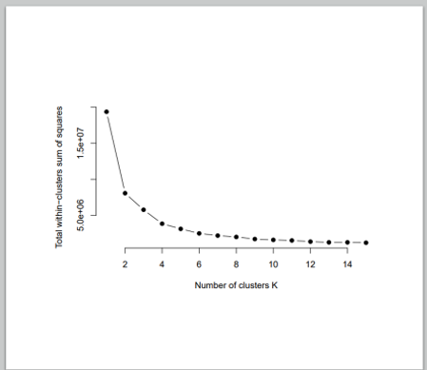
K-MEANS
Optical number of cluster using elbow method.

Slide 12
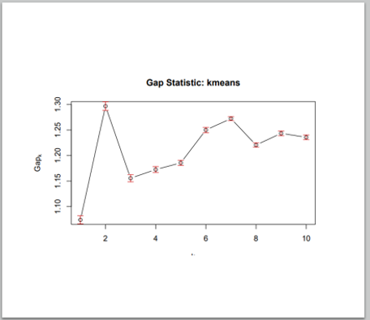
Optical number of clusters using GAP statistic

Slide 13
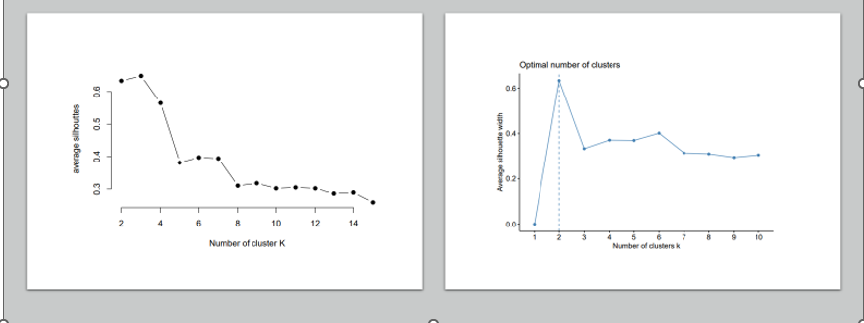
Optical number of clusters using Silhouette

Slide 14
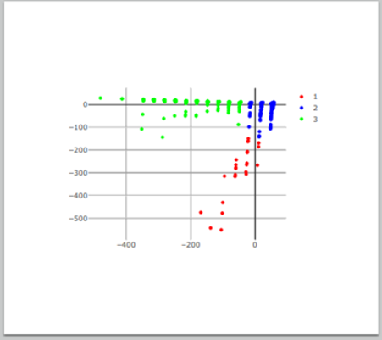
Cluster Visualization using K-means

Slide 15
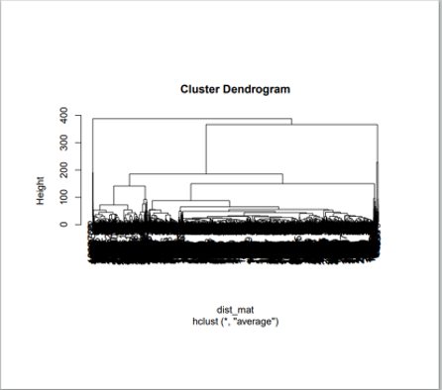
Cluster with Hierarchical using method average

Slide 16
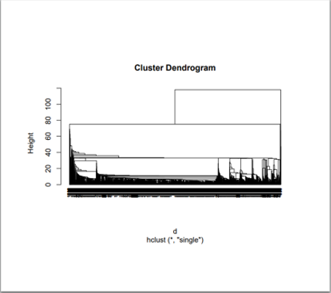
Cluster with Hierarchical using method single

Slide 17
CONCLUSION
Out of all the models we received highest accuracy for Random Forest Classifier, and hence we can choose this model to classify the patients accurately.
Models | Accuracy
Random Forest | 99.93
Decision Tree | 99.36
Naïve Bayes | 91.05
K-Nearest Neighbor | 90.57

